Slide 1
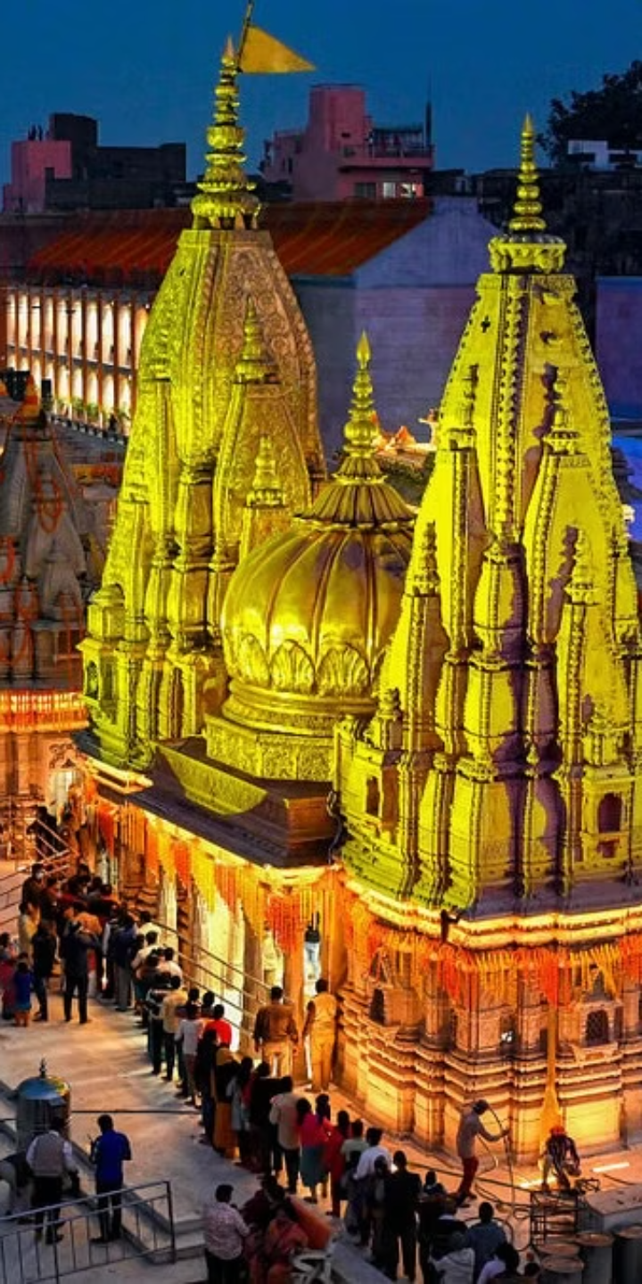
Sanatani – Journey Through India's Sacred Temples & Timeless Traditions
Welcome to an engaging tour of our travel website. Explore features designed for easy trip planning and unforgettable experiences.
Made by:— Muskan Gupta & Aastha Bharti

Slide 2

Introduction.
Sanatani is a dedicated platform that helps people explore and visit famous Hindu temples across India. It provides detailed information about each temple, along with travel and accommodation services, making spiritual journeys easier for devotees and tourists.

Slide 3
User-Friendly Interface and Search.
Intuitive Navigation
Powerful Search
Intuitive Navigation refers to a user interface design approach that makes it easy for users to find what they’re looking for without confusion or unnecessary effort. On your Sanatani website, here’s how you can implement Intuitive Navigation to ensure a user-friendly experience
A Powerful Search feature enhances the user experience by allowing visitors to quickly find relevant information without browsing through multiple pages. For your Sanatani website—which likely includes a wide range of temples, services, hotels, and cultural content—here’s how to build a robust and powerful search system

Slide 4
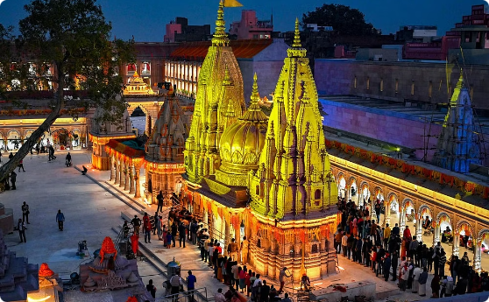
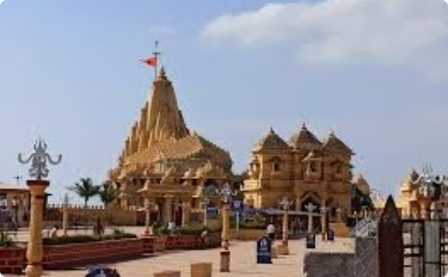
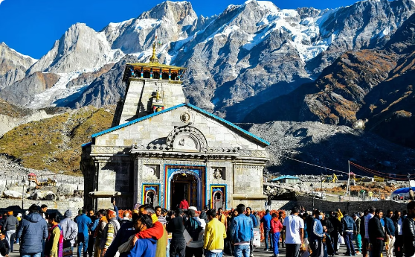
Destinations
Kashi Vishwanath Temple.
The Kashi Vishwanath Temple is one of the most famous Hindu temples dedicated to Lord Shiva. Located in Varanasi, Uttar Pradesh, it stands on the western bank of the holy river Ganga and is one of the twelve Jyotirlingas, the holiest of Shiva temples.
Somnath temple.
The Somnath temple located in Prabhas Patan near Veraval in Saurashtra on the western coast of Gujarat, India is believed to be the first among the twelve Jyotirlinga shrines of Shiva.
Kedarnath
Kedarnath Temple is one of the most revered and ancient Hindu temples in India, dedicated to Lord Shiva. It holds immense religious, historical, and cultural significance and is a key part of the Char Dham Yatra (along with Badrinath, Gangotri, and Yamunotri).

Slide 5
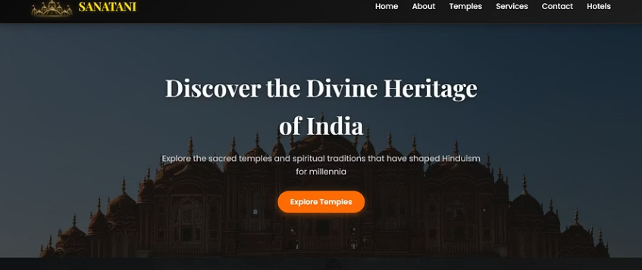
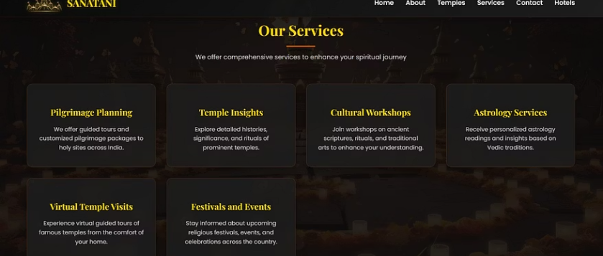
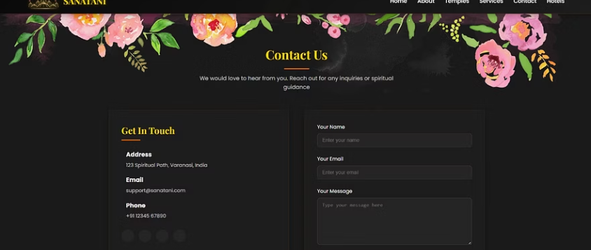
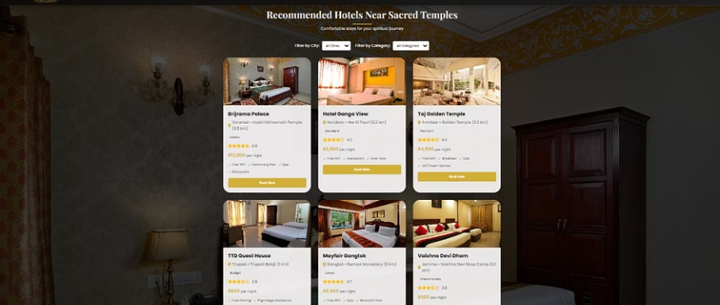
Overview of Website Page's.

Slide 6
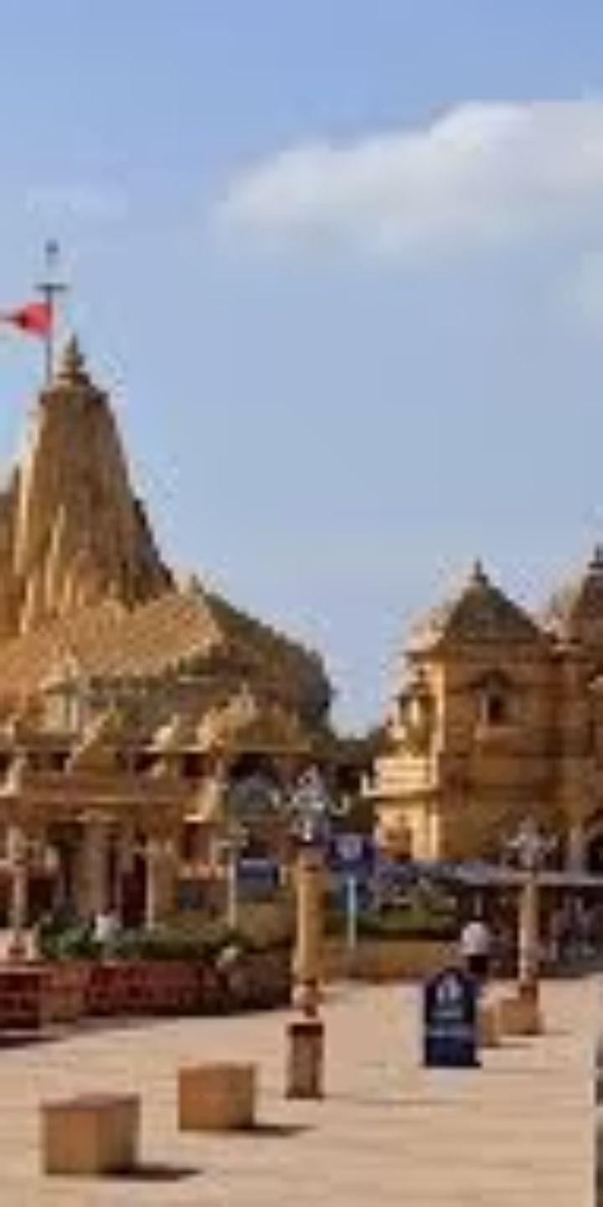

Travel Guides and Expert Tips
Insider Recommendations
Packing Tips
Traveling to Kedarnath, especially through mountainous terrain and high altitudes, requires smart and mindful packing. Here’s a curated checklist to help you stay comfortable, safe, and spiritually focused during your journey.
To make your spiritual journey to Kedarnath smooth, memorable, and spiritually enriching, here are insider recommendations from seasoned travelers and local experts.
Safety Protocols
Visiting Kedarnath involves high-altitude trekking, unpredictable weather, and remote locations. Following proper safety protocols ensures a safe, smooth, and spiritually fulfilling journey. Here’s a comprehensive guide

Slide 7
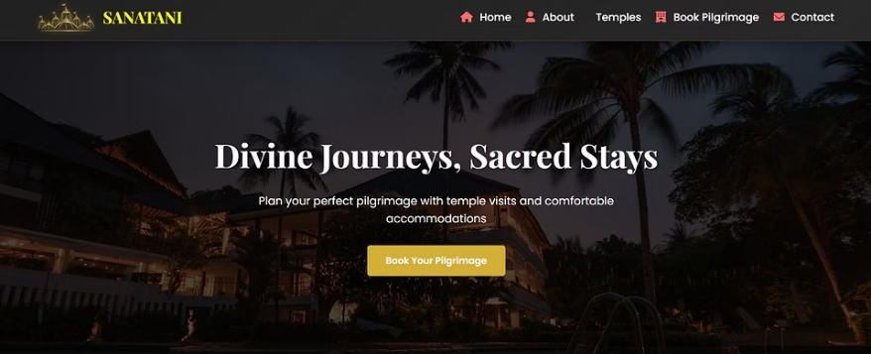
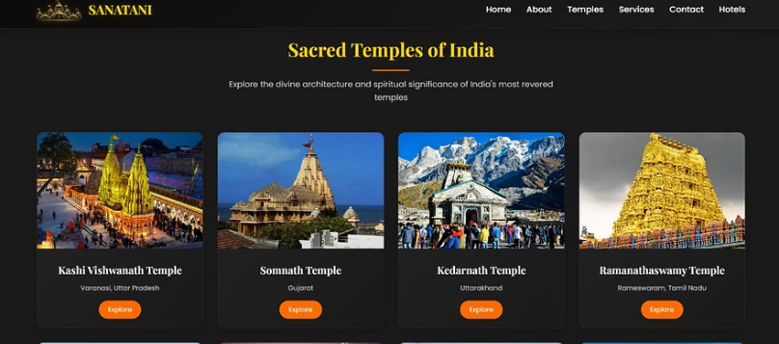

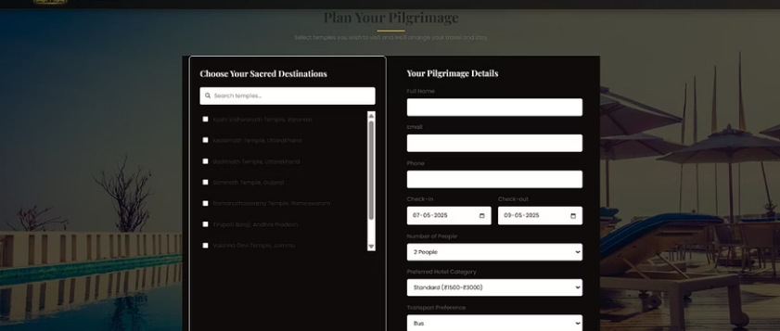
Important parts for Customer's Booking.

Slide 8

Customer Reviews
Shivan from Prayagraj
Aastha from Agra
Visiting Kedarnath through the Sanatani platform was one of the most transformative experiences of my life. The website’s guides were incredibly detailed—packing tips, spiritual insights, and even local dos and don’ts helped me feel fully prepared. I was nervous traveling solo from the U.S., but everything felt smooth, safe, and sacred.
As someone deeply interested in history and spirituality, the Sanatani website offered more than just travel info—it gave me cultural context, temple stories, and genuine insider tips. From the moment I landed in Delhi to my final trek to Kedarnath, everything was well-guided.
Prakarsh from Prayagraj
I’ve always been fascinated by Indian spirituality, but planning a pilgrimage from abroad felt overwhelming—until I found the Sanatani website. The way it broke down each aspect—from temple history to safety protocols—made everything so accessible and reassuring.

Slide 9
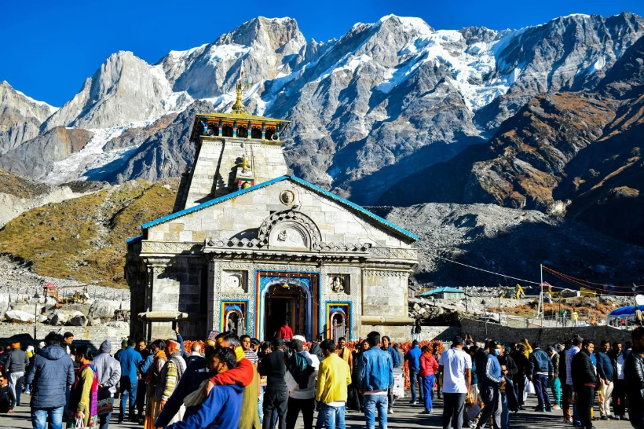
Summary
Sanatani is a dedicated platform that simplifies spiritual journeys by offering comprehensive information on famous Hindu temples across India. Alongside temple details, it provides travel and accommodation assistance, ensuring a seamless and enriching experience for devotees and tourists alike.
This version keeps it concise while highlighting the key offerings (temple info, travel, and accommodation) and the target audience (devotees/tourists). Let me know if you'd like any tweaks! 🙏

Slide 10

Thank You

